Slide 1
Unit-III
STREAM COMPUTING
Ref:-Mining of Massive Datasets, Chapter 4
Jure Leskovec,Anand Rajaraman & Jeffrey D.Ullman
Dr. E . Sivasankar
NIT,Trichy

Slide 2
Syllabus
Stream Computing : Introduction to Streams- Concepts – Stream data model and architecture
Stream Computing, Sampling data in a stream – Filtering streams – Counting distinct elements in a stream – Estimating moments – Counting oneness in a window – Decaying window -
Realtime Analytics Platform(RTAP) applications IBM Infosphere – Big data at rest – Infosphere streams –
Data stage – Statistical analysis – Intelligent scheduler – Infosphere Streams

Slide 3
What is Data Stream?
Traditionally, all our data is available when we want it, usually in the form of a database.
But, in the case of real-time data, we shall make another assumption: data arrives in a stream or streams,and if it is not processed immediately or stored, then it is lost forever.
And it is also not feasible to store it all in active storage and then interact with it at the time of our choosing.
Data Streams
The data that arrives so rapidly that it is not feasible to store all in active storage (i.e., in a conventional database), and then interact with it at the time of our choosing.

Slide 4
Characteristics of Algorithms for processing data stream
Algorithms for stream processing must specify some way to :
summarize the stream in some way
filter a stream to eliminate most of the “undesirable” elements.
estimate the number of different elements in a stream using much less storage than would be required if we listed all the elements we have seen.

Slide 5
Characteristics of Algorithms for processing data stream
Algorithms for stream processing must specify some way to :
summarize the stream in some way
filter a stream to eliminate most of the “undesirable” elements.
estimate the number of different elements in a stream using much less storage than would be required if we listed all the elements we have seen.

Slide 6
Characteristics of Algorithms for processing data stream
Algorithms to summarize the stream
approach to summarizing a stream is to look at only a fixed-length “window” consisting of the last n elements for some (typically large) n.
We then query the window as if it were a relation in a database.
If there are many streams and/or n is large, we may not be able to store the entire window for every stream, so we need to summarize even the windows.

Slide 7
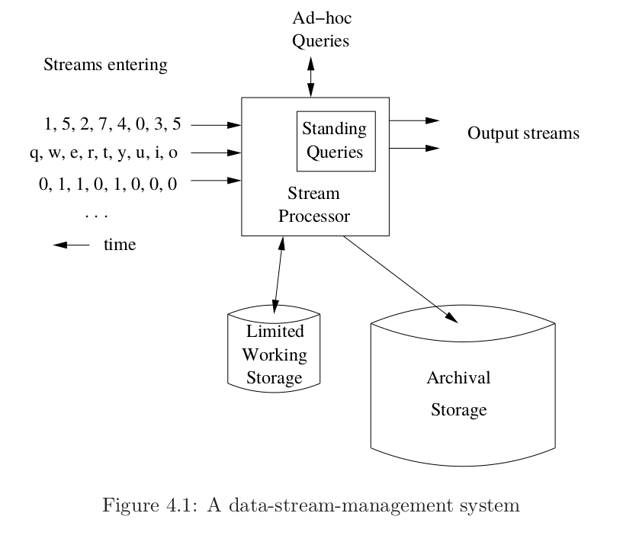
A Data Stream Managment System – Stream Processor
In analogy to a database-management system, we can view a stream processor as a kind of data-management system.

Slide 8
Stream Processor
Data Streams Versus DBMS: Any number of streams can enter the system. Each stream can provide elements at its own schedule; they need not have the same data rates or data types, and the time between elements of one stream need not be uniform.
The fact that the rate of arrival of stream elements is not under the control of the system distinguishes stream processing from the processing of data that goes on within a database-management system.
The latter system controls the rate at which data is read from the disk, and therefore never has to worry about data getting lost as it attempts to execute queries

Slide 9
Stream Processor
Characteristics of Data Streams : Any number of streams can enter the system. Each stream can provide elements at its own schedule; they need not have the same data rates or data types, and the time between elements of one stream need not be uniform.
Archival Store : Streams can be archived in a large archival store, but it is not possible to answer queries from the archival store.
- Archival stores could be examined only under special circumstance using time-consuming retrieval processes.
Working Store : The summaries or parts of streams placed in working store can be used for answering queries.
- The working store might be disk, or it might be main memory, depending on how fast we need to process queries. It is of sufficiently limited capacity that it cannot store all the data from all the streams.

Slide 10
Stream Queries
Two types of queries: a) Standing Queries b) Adhoc Queries
Standing queries executes permanently in the system and produce outputs at appropriate times.
Standing queries are easy to answer.
For example,
▪ Suppose a sensor which has been deployed to record ocean surface temperature, might have a standing query to output an alert whenever the temperature exceeds 25 degrees centigrade. Answer depends only on the most recent stream element.

Slide 11
Stream Queries (contd.)
Alternatively, we might have a standing query that, each time a new reading arrives, produces the average of the 24 most recent readings. That query also can be answered easily, if we store the 24 most recent stream elements. When a new stream element arrives, we can drop from the working store the 25th most recent element, since it will never again be needed
Another query might be asked is the maximum temperature ever recorded by the sensor. In this case, it is not necessary to store the entire stream. When a new stream element arrives, it can be compared with the stored maximum, and set the maximum to whichever is larger.
If the query is to output the average temperature over all time, it is needed to store only two values: the number of readings ever seen in the stream and the sum of those readings.

Slide 12
Stream Queries (contd.)
Adhoc Queries
Adhoc query is a question asked once about the current state of a stream or streams.
Adhoc queries need to store all streams in their entirety to answer them.
If it is expected earlier what kind of queries will be asked through the ad-hoc query interface, then appropriate parts or summaries of streams can be stored as seen in standing queries.
A common approach to answer variety of adhoc queries is to maintain a sliding window of each stream in the working store.
A sliding window can be the most recent n elements of a stream, for some n, or it can be all the elements that arrived within the last t time units.

Slide 13
Example for adhoc query :
  Web sites often like to report the number of unique users over the past month. In this case user logins are to be stored as stream elements associated with the login times. If the most recent month logins are stored as a window as a relation Logins(name, time), then it is simple to get the number of unique users over the past month.
The SQL query is:
    SELECT COUNT(DISTINCT(name))
    FROM Logins
    WHERE time >= t;
  Here, t is a constant that represents the time one month before the current time.

Slide 14
Examples of Stream Sources
Image Data
Satellites often send down to earth streams consisting of many terabytes of images per day. Surveillance cameras produce images with lower resolution than satellites, but there can be many of them, each producing a stream of images at intervals like one second.
Internet and Web Traffic
Web sites receive streams of various types. For example, Google receives several hundred million search queries per day. Yahoo! accepts billions of “clicks” per day on its various sites. Many interesting things can be learned from these streams. A sudden increase in the click rate for a link could indicate some news connected to that page.
Sensor Data
Imagine a temperature sensor in the ocean, sending back to a base station a reading of the surface temperature each hour. The data produced by this sensor is a stream of real numbers

Slide 15
Issues in Stream Processing
Streams often deliver elements very rapidly that need to process in real time, Otherwise information will be lost from processing.
• It is important that the stream-processing algorithm is executed in main memory, without access to secondary storage or with only rare accesses to secondary storage.
• Streams are slow in some cases, there may be many such streams that process all together. Then they may exceed the amount of available main memory .
Thus, many problems about streaming data would be easy to solve if we had enough memory. But it is better to invent new techniques in order to execute them at a realistic rate on a machine of realistic size.

Slide 16
Generalizations about stream algorithms
It is much more efficient to get an approximate answer to our problem than an exact solution.
• A variety of techniques related to hashing turn out to be useful.
• These techniques introduce useful randomness into the algorithm’s behavior, in order to produce an approximate answer that is very close to the true result.
Hence, there is need to manage the streaming data.

Slide 17
Managing streaming data
There are two ways of managing streaming data.
▪ Sampling data in a stream
▪ Filtering streams

Slide 18
Sampling data in a stream
Sampling data in a stream is selecting a subset of a stream so that queries can be asked about the selected subset and have the answers be statistically representative of the stream as a whole.
Since entire system cannot be stored, storing a sample is one obvious solution.
There are two different approaches in sampling from a data stream:
▪ Maintain a random sample of fixed size over a potentially infinite stream
▪ Varying the sample size

Slide 19
A data stream is a massive, infinite dataset. Hence it is not possible to store the entire stream. While mining a data stream a typical question that can arise is how can we answer certain critical queries without storing the entire stream. In some cases, we can get an answer from certain samples in the stream, without examining the entire stream.
Here, we have to keep in mind two things; one is the sample should be unbiased. The second one is the typical sample should be able to answer the queries. Choosing the right samples is critical. Carelessly choosing samples can destroy the results of the query.

Slide 20
An Example for Random Sampling
Let us suppose at any time k, the property to maintain the sample of fixed size of s elements is , for all k elements seen so far, should have equal probability of being sampled.
Ex 1 : A search engine receives a stream of queries and it would like to study the behaviour of typical users. We assume the stream consists of tuples (user, query, time).
The query is to find out - how often did a user run the same query in a month? Assume we have the storage space of 1/10th of the stream elements.
Solution : Generate a random integer in [0..9] for each query and store the query if the integer is 0, otherwise discard. Then each user has, on average, 1/10th of their queries stored. The idea is that most users will have a fraction quite close to 1/10th of their queries stored.

Slide 21

Ex 2 : Suppose each user issues x queries once and d queries twice (total of x+2d queries), What fraction of queries by an average search engine user are duplicates?
Soln: Suppose 10% of the queries are considered for sampling which contain x/10 of the singleton queries and 2d/10 of the duplicate queries at least once
Of d search queries issued twice, d/100 queries appear twice in sample,
d/100 =1/10 ∙ 1/10 ∙ d
Of d “duplicates” 18d/100 appear exactly once, 18d/100 = ((1/10 ∙ 9/10)+(9/10 ∙1/10))∙d
So the sample-based answer is =
But this is wrong, the generalized correct answer is d/(x+d) .

Slide 22
Obtaining a Representative Sample
Solution
A solution for the previous scenario is to sample the users.
Pick 1/10th of users and take all their searches in the sample.
Use a hash function that hashes the user name or user id uniformly into 10 buckets.
Each time a search query arrives in the stream, we look up the user to see whether or not they are in the sample. If so, we add this search query to the sample, and if not, then not.
By using a hash function, one can avoid keeping the list of users.
Hash each user name to one of ten buckets, 0 through 9. If the user hashes to bucket 0, then accept this search query for the sample, and if not, then not.

Slide 23
Filtering the streams
Another common process on streams is selection, or filtering.
• Filtering is a process of accepting those tuples in the stream that meet a certain criterion.
• Accepted tuples are passed to another process as a stream, while other tuples are dropped.
• The easy way of filtering is putting selection criterion on the tuple that can be calculated (e.g., the first component is less than 10).
• The problem becomes harder when the criterion involves lookup for membership in a set.
• It is especially hard, when that set is too large to store in main memory. There are several filters available.
Eg: Bloom filter

Slide 24
Bloom Filter
• Bloom filtering is an effective technique to eliminate tuples that do not meet the criterion involved with the membership in a set.
A Bloom filter consists of:
1. An array of n bits, initially all 0’s.
2. A collection of hash functions h₁ , h₂ , h₃ , ............, h_{k} . Each hash function maps “key” values to n buckets, corresponding to the n bits of the bit-array.
3. A set S of m key values.
The purpose of the Bloom filter is to allow through all stream elements whose keys are in S, while rejecting most of the stream elements whose keys are not in S.

Slide 25
Bloom Filter
To initialize the bit array, begin with all bits 0. Take each key value in S and hash it using each of the k hash functions. Set to 1 each bit that is h_{i}(K) for some hash function h_{i} and some key value K in S.
To test a key K that arrives in the stream, check that all of h₁(k), h₂(k), h₃(k),
............, h_{k}(k) are 1’s in the bit-array.
If all are 1’s, then let the stream element through. If one or more of these bits are 0, then K could not be in S, so reject the stream element.

Slide 26
Bloom filter - Example
Use N = 11 bits for our filter
Stream elements = integers
Use two hash functions
  H1(x) = Take odd numbered bit from the input stream – X and result is X mod 11
  H2(x) = Take even numbered bit from the input stream – X and result is X mod 11

Slide 27
Filtering the Stream
Stream Element | H1(x) | H2(x) | Filter Content
Initial
= 11001 Odd --> 101 (5) Even --> 10 (2) | 5 | 2
= 10011111 Odd --> 0111(7) Even --> 1011(11) | 7 | 0
585 = 1001001001 Odd → 01001 (9) Even → 10010 (18) | 9 | 7
0 | 0 | 0 | 0 | 0 | 0 | 0 | 0 | 0 | 0 | 0
0 | 0 | 1 | 0 | 0 | 1 | 0 | 0 | 0 | 0 | 0
1 | 0 | 1 | 0 | 0 | 1 | 0 | 1 | 0 | 0 | 0
1 | 0 | 1 | 0 | 0 | 1 | 0 | 1 | 0 | 1 | 0

Slide 28
Bloom Filter – Look Up
Suppose we have the same Bloom filter as before and we have set the filter to 10100101010.
Lookup element y = 118 = 1110110 (binary)
Odd = 1110 and Even = 101
H1(y) = 14 mod 11 = 3
H2(y) = 5 mod 11 = 5
Bit 5 is 1, but bit 3 is 0
So we are sure that y is not in the set.

Slide 29
Bloom Filter
It is used in Email Spam Detection
Bloom filters guarantee no false negatives, and use limited memory
Suitable for hardware implementation since Hash function computations can be parallelized
Issues
  Creates false positives

Slide 30
A Motivating Example
Suppose we have a set S of one billion allowed email addresses, that can be allowed through with a belief that they are not spam. The stream consists of pairs: an email address and the email itself.
Since the typical email address is 20 bytes or more, it is not reasonable to store S in main memory. Thus, a filtering method should be devised to filter most of the undesired stream elements that requires no more main memory than available.

Slide 31
Email filtering (Using bloom filter)
• In Bloom filtering, main memory is used as a bit array. Suppose there is eight billion bits space of main memory, devise a hash function h from email addresses to eight billion buckets.
• Hash each member of S to a bit, and set that bit to 1. All other bits of the array remain 0.
• Since there are one billion members of S (from eg. 1. ), approximately 1/8th of the bits will be 1.
• The exact fraction of bits set to 1 will be slightly less than 1/8th, because it is possible that two members of S hash to the same bit.
• When a stream element arrives, apply hash function to its email address. If the bit to which that email address hashes is 1, then the email will be let through.
• But if the email address hashes to a 0, means that the address is not in S, so we can drop this stream element.

Slide 32
Email filtering (Using bloom filter)
• Unfortunately, some spam email will get through. Approximately 1/8th of the stream elements whose email address is not in S will happen to hash to a bit whose value is 1 and will be let through.
• Nevertheless, since the majority of emails are spam (about 80% according to some reports), eliminating 7/8th of the spam is a significant benefit.
• Moreover, if every spam is to be eliminated, checking for its membership in S is enough to decide those good and bad emails that get through the filter. Those checks will require the use of secondary memory to access S itself.
• As a simple example, cascade of filters can also be used, each of which would eliminate 7/8th of the remaining spam.

Slide 33
Analysis of Bloom Filtering
If a key value is in S, then the element will surely pass through the Bloom filter (false positives). However, if the key value is not in S, it might still pass.
• Consider n is the bit array length, m is the number of members of S and k is the number of hash functions. Then it is important to calculate the probability of a false positive, as a function of n,m and k.
• Calculating false positives will be like throwing darts at targets.

Slide 34
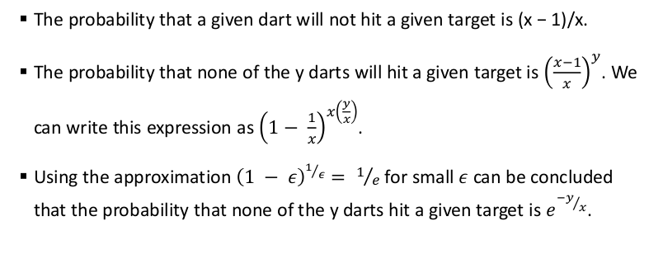
Analysis of Bloom Filtering
Example : The model to use is throwing darts at targets. Suppose we have x targets and y darts. Any dart is equally likely to hit any target. After throwing the darts, how many targets can we expect to be hit at least once?
.
Target : Each bit in the bit array, Dart : Each member of S mapped by hash , the set of key values. Then the probability that a given bit will be 1 is the probability that the corresponding target will be hit by one or more darts.

Slide 35
We can apply the rule to the more general situation, where set S has m members, the array has n bits, and there are k hash functions. The number of targets is x = n, and the number of darts is y = km.
Thus, the probability that a bit remains 0 is e −km/n .
The probability of a false positive is the probability of a 1 bit, which is 1−e^{−km/n} raised to the kth power, i.e., (1 − e ^{−km/n} )^{k}

Slide 36
Counting Distinct Elements in a Stream
Suppose stream elements are chosen from some universal set.
We would like to know how many different elements have appeared in the stream, counting either from the beginning of the stream or from some known time in the past.
This is called Count-Distinct Problem.

Slide 37
Examples
Ex 1: A Website wants to count the number of unique users viewing each of its pages in a month.
Ex 2 : Web site like Google that does not require login to issue a search query, and may be able to identify users only by the IP address from which they send the query.
Ex 3: A Website wants to count the number of unique users viewing each of its pages in a month

Slide 38
The Flajolet-Martin Algorithm
Consider Input stream of integers : 1, 3, 2,1, 2, 3, 4, 3, 1, 2, 3, 1
Hash function h(x): (6x+1) mod 5
h(1) =(6 *1 + 1) mod 5
= 7 mod 5
= 2

Slide 39
For the Input stream:
1, 3, 2,1, 2, 3, 4, 3, 1, 2, 3, 1
Hash function: (6x+1) mod 5
h(1) = 2 ;
h(3) = 4 ;
h(2) = 3 ;
h(1) = 2 ;
h(2) = 3 ;
h(3) = 4 ;
h(4) = 0 ;
h(3) = 4 ;
h(1) = 2 ;
h(2) = 3 ;
h(3) = 4 ;
h(1) = 2 ;

Slide 40
Consider Input stream of integers :
1, 3, 2,1, 2, 3, 4, 3, 1, 2, 3, 1
Find the trailing Zeros
h(1) = 2 ; (010) r = 1
h(3) = 4 ; (100) r = 2
h(2) = 3 ; (011) r =0
h(1) = 2 ; (010) r = 1
h(2) = 3 ; (011) r = 0
h(3) = 4 ; (100) r = 2
h(4) = 0 ; (000) r = 0
h(3) = 4 ; (100) r = 2
h(1) = 2 ; (010) r = 1
h(2) = 3 ; (011) r = 0
h(3) = 4 ; (100) r = 2
h(1) = 2 ; (010) r = 1

Slide 41
In above examples,
Maximum tail length R = 2
So, the estimate is 2^{R} = 2² = 4
This means that there are 4 distinct elements in the stream.

Slide 42
The Flajolet-Martin Algorithm
Estimate the number of distinct elements by hashing the elements of the universal set to a bit-string that is sufficiently long.
Pick many different hash functions and hash each element of the stream using these hash functions.
Whenever we apply a hash function h to a stream element a, the bit string h(a) will end in some number of 0’s, possibly none.
Call this number the tail length for a and h. Let R be the maximum tail length of any ‘a’ seen so far in the stream.
Then we shall estimate 𝟐^{𝐑} for the number of distinct elements seen in the stream.

Slide 43
Counting distinct elements contd..
Combining Estimates
• FM algorithm works in iteration manner and applies different hash functions to the one pass of a stream in each iterative and calculates the Estimates.
• Now there is a need to combine these estimates in some way to get the final estimation of unique elements in a stream.
• Combining the estimates can be done in two ways....
1)Take the mean of the values 2^{R} that we get from each hash function.
2)Take the median of the estimates.

Slide 44
Counting distinct elements contd..
Combining Estimates
• Problems associated with these two methods are....
-- If mean is used there is a chance for outliers to come into the estimation result.
-- The median suffers from a defect that it is always gives the result in a power of 2,
no matter how many hash functions we use.
There is a solution to the problem to combine the two methods.
• First, group the hash functions into small groups, and take their average. Then, take the median of the averages.
Taking the median of group averages will reduce the influence of this effect almost to nothing.
• In order to guarantee that any possible average can be obtained, groups should be of size at least a small multiple of log₂m.

Slide 45
Counting distinct elements contd..
Space Requirements
• If we observe that as we read the stream it is not necessary to store the elements seen.
• The only thing we need to keep in main memory is one integer per hash function; this integer records the largest tail length seen so far for that hash function and any stream element.
• If the stream contains n elements with m of them are unique, this algorithm needs O(log m) memory.

Slide 46
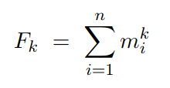
Estimating Frequency Moments of Streams
Consider a stream S={a₁,a₂,...,a_{m}}with elements from a domain D={v₁,v₂,...,v_{n}}.
Let m_{i} denote the frequency(also sometimes called multiplicity) of value v_{i}∈D; i.e., the number of times v_{i} appears in S.
The kth frequency moment of the stream, F_{k}, is defined as:

Slide 47
• That is, the 0th moment is a count of the number of distinct elements in the stream.
• The 1st moment is the sum of the m’s, which must be the length of the stream. Thus, first moments are especially easy to compute; just count the length of the stream seen so far.
• The second moment is the sum of the squares of the m’s. It is sometimes called the surprise number, since it measures how uneven the distribution of elements in the stream.

Slide 48
• For example, suppose we have a stream of length 100, in which eleven are different elements,
• The most even distribution of these eleven elements would have one appearing 10 times and the other ten appearing 9 times each. In this case, the surprise number is 10² + 10 × 9² = 910.
• At the other extreme, one of the eleven elements could appear 90 times and the other ten appear 1 time each. Then, the surprise number would be
90² + 10 × 1² = 8110.

Slide 49
Why to estimate moments?
• There is no problem computing moments of any order if we can afford to keep in main memory a count for each element that appears in the stream.
• If we cannot afford to use that much memory, then we need to estimate the k^{th} moment by keeping a limited number of values in main memory and computing an estimate from these values.

Slide 50
Alon-Matias-Szegedy Algorithm for Second Moments
• Let us assume that a stream has a particular length n. Suppose we do not have enough space to count all the m ’s for all the elements of the stream. We can still estimate the second moment of the stream using a limited amount of space using this algorithm.
• We compute some number of variables. For each variable X, we store:
• A particular element of the universal set, which we refer to as X.element
• An integer X.value, which is the value of the variable. To determine the value of a variable X, we choose a position in the stream between 1 and n, uniformly and at random. Set X.element to be the element found there, and initialize X.value to 1. As we read the stream, add 1 to X.value each time we encounter another occurrence of X.element .
• The formula to estimate the second moment is n(2X.value − 1)

Slide 51
Estimating Moments contd...
Suppose the stream is a, b, c, b, d, a, c, d, a, b, d, c, a, a, b.
The length of the stream n = 15.
a appears 5 times, b appears 4 times, and c and d appear three times each.
Then second moment = 5² + 4² + 3 ²+ 3² = 59.
By using AMS algorithm, suppose we keep three variables, X₁ , X ₂, and X₃ and
at “random” we pick the 3rd, 8th, and 13th positions to define these three variables. Then
  X₁ .element = c ; X₁ .value = 3
  X₂ .element = d ; X₂ .value = 2
  X₃ .element = a; X₃ .value = 2

Slide 52
Estimating Moments contd...
• Now we can derive an estimate of the second moment from any variable X from AMS estimate formula n(2X .value − 1)
For X₁ Estimate = 15 × (2 × 3 − 1) = 75.
For the variable X₂ Estimate = 15 ×(2 ×2 −1) = 45.
For the variable X₃ Estimate = 15 ×(2 ×2 −1) = 45.
• Average of the three estimates is 55, which is a fairly close approximation to actual second moment 59.

Slide 53
Counting one’s in a window
This problem deals with counting of number of 1’s in a given window of length N.
More precisely, we answer queries of the form “how many 1’s are there in the last k bits?”
where k<=N for a window of length N.
Some applications of counting one’s :
In an e-commerce website there are thousands of products and millions of transactions.
We can have an vector of 0/1 to indicate if a product X is sold in any nth transaction.
The query on this stream is like - how many times we have sold X in the last K sales,
in essence we have to count 1’s in the last K bits.
On the same line we can represent the users who purchased the products using 0/1
So the query can be asked like how many users did purchased products in last K transactions,
In essence we have to count 1’s in the last K bits.

Slide 54
Datar-Gionis-Indyk-Motwani (DGIM) Algorithm
This algorithm estimate the number of 1’s in the window with an error of no more than 50% (ie with a precise of 50%).
Each bit stream has a timestamp, the position in which it arrives.
• The first bit has timestamp1, the second has timestamp2, and so on.
• The positions are recognized with the window size N.
• The timestamp is represented with modulo N, and are represented as log2 N bits

Slide 55
Buckets
According to DGIM algorithm ,the windows are divided into buckets, consisting of
▪ The timestamp of its right (most recent) end
▪ The number of 1’s in the bucket must be in the power of 2, which is referred to as size of bucket.
Rules for forming buckets
1. The right end of the bucket should always be a position with a 1.
2. Every position with a 1 is in some bucket.
3. No position is in more than one bucket.
4. All bucket sizes should be a power of 2.
5. Minimum 1 and maximum 2 buckets are allowed with the same size
6. Every bucket should have at least one 1, else no bucket can be formed.
7. The buckets cannot decrease in size as we move to the left.

Slide 56
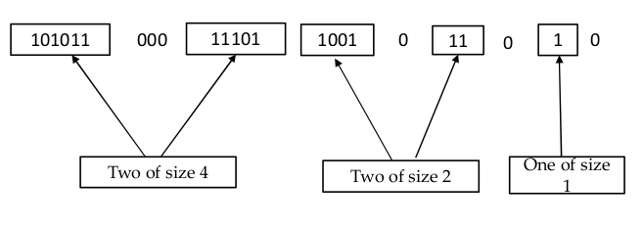
Partition the given input stream into buckets using DGIM
101011000111011001011010.
N=24

Slide 57
Storage Requirement
The total number of bucket is O(log N).
Each bucket can be represented by O(log N) bits.
Thus the total storage requirement is O(log N) * O(log N) = O(log² N)

Slide 58
To estimate the number of 1s in the most recent K bits:
Find the bucket b with the earliest timestamp that includes at least some of k most recent bits
Sum the sizes of all buckets to the right than bucket b (“size” means the number of 1s in the bucket)
Add half the size of the bucket b
Note: We do not know how many 1s of the last bucket are still within the wanted window

Slide 59
Updating Buckets
When a new bit comes in, drop the last (oldest) bucket if its end-time is prior to N time units before the current time.
2 cases: Current bit is 0 or 1
If the current bit is 0:
no other changes are needed

Slide 60
Updating Buckets
If the current bit is 1:
(1) Create a new bucket of size 1, for just this bit
End timestamp = current time
(2) If there are now three buckets of size 1,
combine the oldest two into a bucket of size 2
(3) If there are now three buckets of size 2,
combine the oldest two into a bucket of size 4
(4) And so on ...

Slide 61
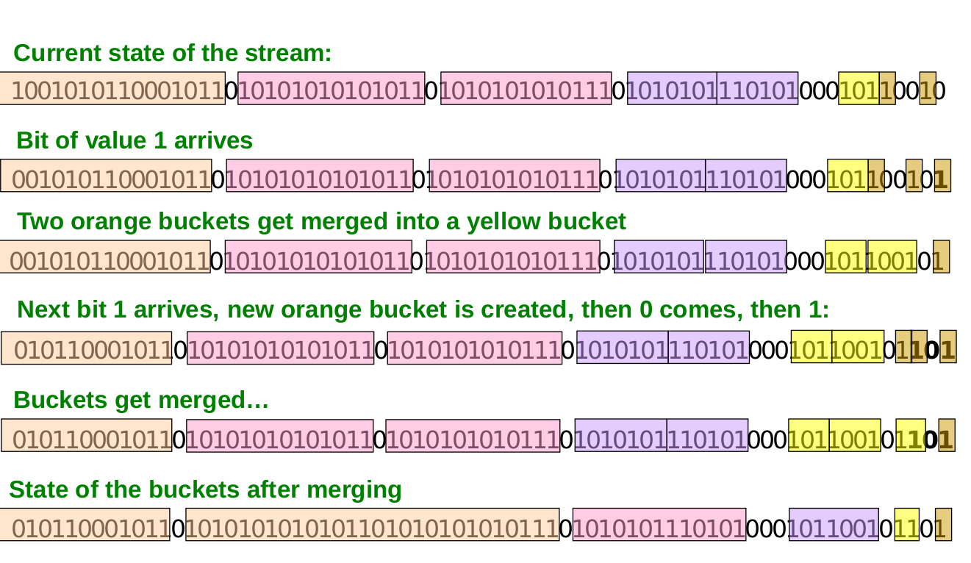
Updating Buckets

Slide 62
How to Query ?
To estimate the number of 1s in the most recent N bits:
1. Sum the sizes of all buckets but the last
(Note: “size” means the number of 1s in the bucket)
2. Add half the size of the last bucket

Slide 63
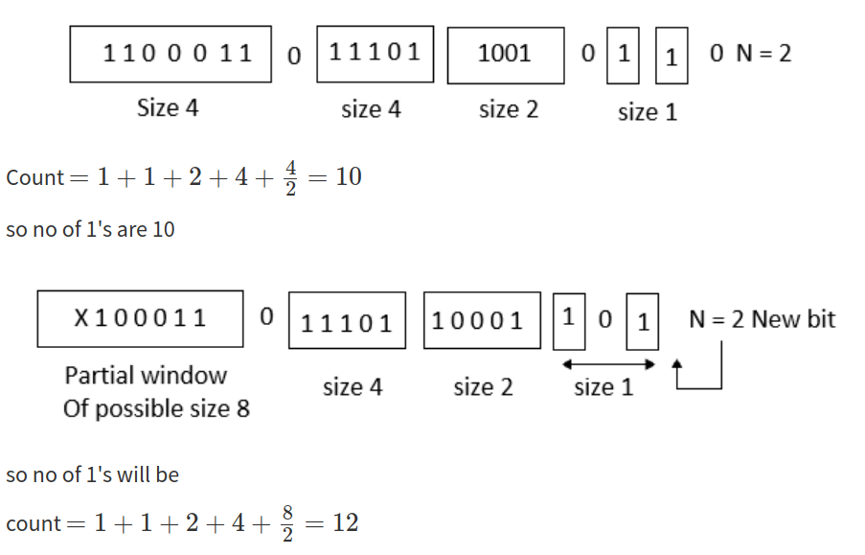
Counting the number of ones
Example 1:

Slide 64
Counting the number of ones
Example 2:

Slide 65
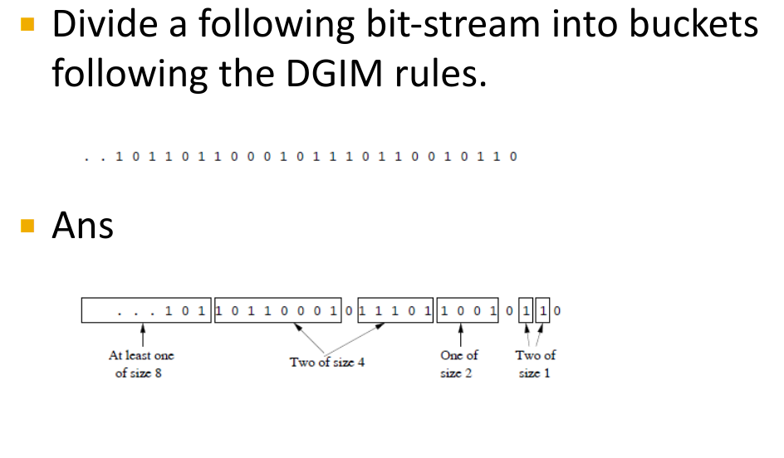
Quiz : Maintaining the DGIM conditions

Slide 66
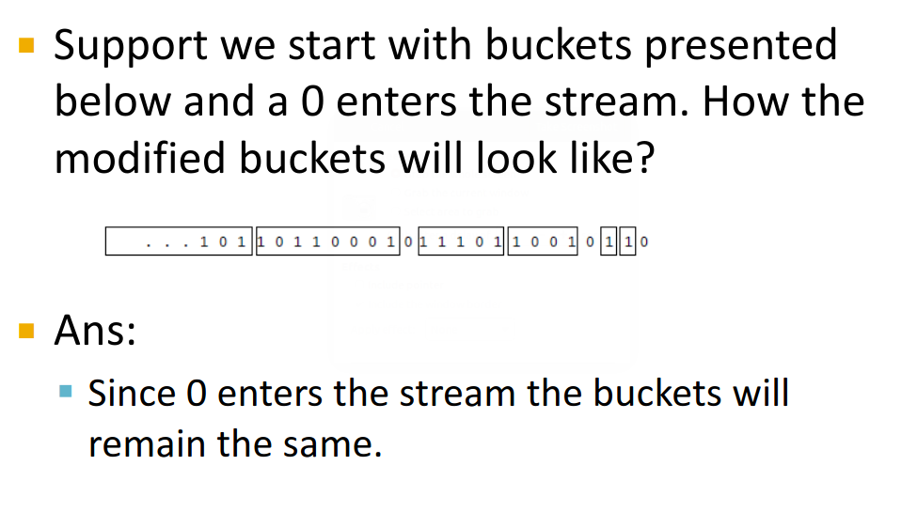
Quiz : Maintaining the DGIM conditions

Slide 67
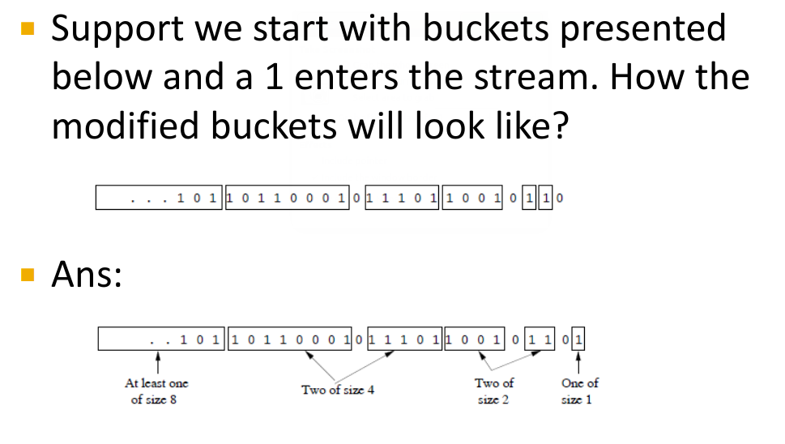
Quiz : Maintaining the DGIM conditions

Slide 68
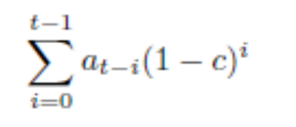
Definition of the Decaying Window
Formally, let a stream currently consist of the elements a₁, a₂, . . . , a_{t}, where a₁ is the first element to arrive and a_{t} is the current element.
Let c be a small constant, such as 10⁻⁶ or 10⁻⁹. Define the exponentially decaying window for this stream to be the sum.
The effect of this definition is to spread out the weights of the stream elements
as far back in time as the stream goes.
In contrast, a fixed window with the same sum of the weights, 1/c, would put equal weight 1 on each of the most recent 1/c elements to arrive and weight 0 on all previous elements

Slide 69
Definition of the Decaying Window
It is much easier to adjust the sum in an exponentially decaying window than in a sliding window of fixed length.
In the sliding window, we have to worry about the element that falls out of the window each time a new element arrives. That forces us to keep the exact elements along with the sum, or to use an approximation scheme such as DGIM. However, when a new element a_{t+1} arrives at the stream input, all we need to do is:
1. Multiply the current sum by 1 − c.
2. Add a_{t+1}.
The reason this method works is that each of the previous elements has now moved one position further from the current element, so its weight is multiplied by 1 − c. Further, the weight on the current element is (1 − c)⁰ = 1, so adding a_{t+1} is the correct way to include the new element’s contribution.

Slide 70
Finding the Most Popular Elements
The problem of finding the most popular movies in a stream of ticket sales
We shall use an exponentially decaying window with a constant c, which you might
think of as 10⁻⁹.
That is, we approximate a sliding window holding the last one billion ticket sales.
For each movie, we imagine a separate stream with a 1 each time a ticket for that movie appears in the stream, and a 0 each time a ticket for some other movie arrives.
The decaying sum of the 1’s measures the current popularity of the movie.
We imagine that the number of possible movies in the stream is huge, so we do not want to record values for the unpopular movies. Therefore, we establish a threshold, say 1/2, so that if the popularity score for a movie goes below this number, its score is dropped from the counting

Slide 71
Finding the Most Popular Elements
The problem of finding the most popular movies in a stream of ticket sales
When a new ticket arrives on the stream, do the following:
1. For each movie whose score we are currently maintaining, multiply its score by (1 − c).
2. Suppose the new ticket is for movie M. If there is currently a score for M, add 1 to that score.
If there is no score for M, create one and initialize it to 1.
3. If any score is below the threshold 1/2, drop that score.

Slide 72
THANK YOU

